Slide 1
International Women And Children’s Burn Foundation
June 2022

Slide 2
Purpose of this mission.
Fact Find Mission. Consideration of opening up 10th comprehensive burn rehabilitation clinic in Nigeria which currently does not exist in your country
Provide care to Ajiboye Oluwatoyin ( a 2.5 year old child). I believe this child is reflective of the challenges faced by family, patient and care providers.

Slide 3
Why Nigeria?
Largest country in Africa with 200,000 million people
Death Rate in LMIC’s: 4.3 per 100,000 people
Death Rate in Nigeria: 21.2 per 100,000 due to fires in 2012 among children less than 5 years of age
Natural Epidemiology of pediatric burns has not been characterized
Primary Causes: Poverty, lack of education/literacy, urbanization, some seasonal implications, kerosene
New for IWCBF is the primary role and involvement of traditional healers

Slide 4
Global Burn Epidemiology=Nigerian Burn Epidemiology
Children Under the age of 15
Cooking related- hot water, hot oil (40-60%)
Flame/Fire (40-60%)
Adulterated Kerosene burns- Nigeria (central)
Adult Females- Self immolation (northeast-forced marriage)
Electrical Burns- Dominican Republic (stealing electricity)
Kite Flying (Windy season in Guatemala City, Guatemala)
15% TBSA (often TBSA size over stated).
Heal via secondary intent (time)

Slide 5
Death vs Deformity & Disability
Most are burned bad enough to become disabled due to scar contracture and deformity but do not die
40% of deaths are often associated with individuals below the age of five.
Cooking Related– on the floor. Kids gathering around while foot is being prepared with hot water, oil.
Deliberate burns to treat convulsions
Harmattan season: cold and dry- need for more fires

Slide 6
Deformity & Disability- Body Locations
Neck, Face, Hands, Groin, Feet
Cost of Care and Intervention- Average Nigerian burn victim earns less than 5 dollars/day. Not affordable.
Traditional Healers: Engine oil, palm oil, dry salt, raw eggs
“Cool the burn”-10 to 20 minutes can reduce complication rate by 50%.
Lack of literacy may lead to mistrust of other forms of knowledge
Lack of infrastructure to manage or care long term
Poverty

Slide 7
Key Points to Remember
Being burned is chapter 1 of a story without an ending
Hands and face are “windows to the world”
Position of comfort is position of Deformity
Young people scar more than older people
Joints scar more than “non joints”– sheering (neck, shoulder, hand)
Darker skin people scar more than fair skinned people
…so we have the “perfect storm” here-

Slide 8
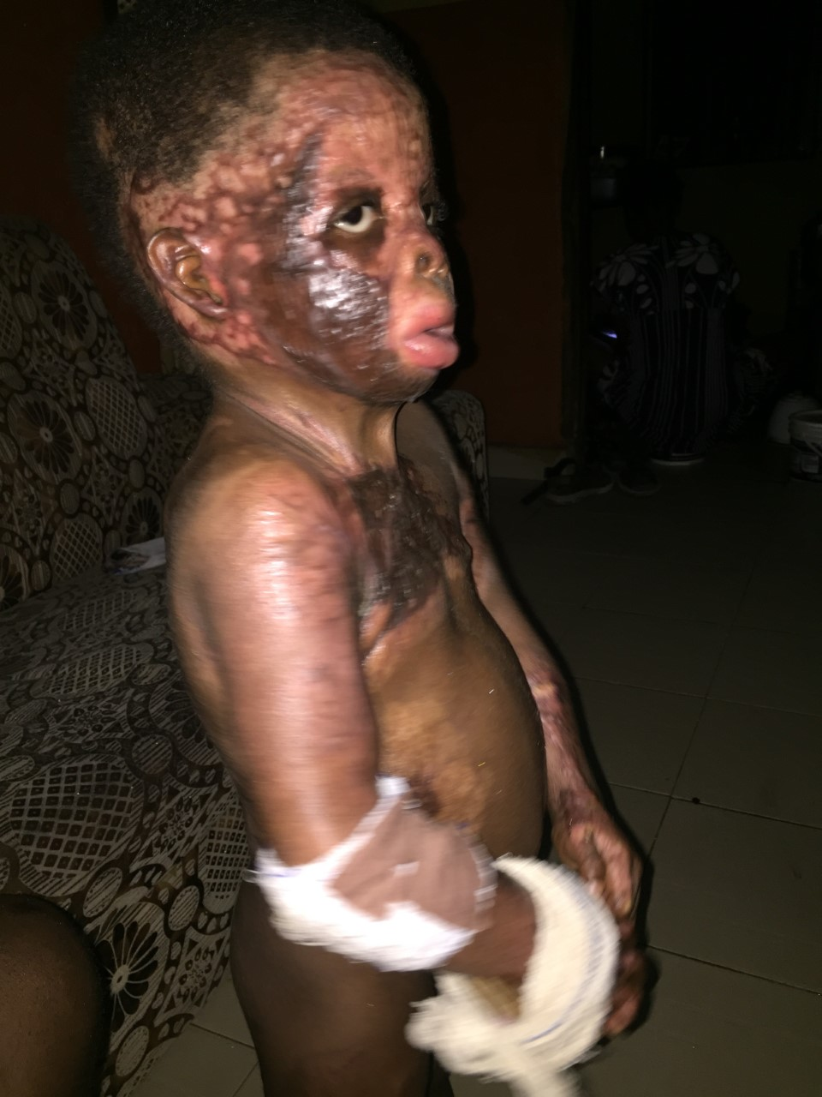
Ajiboye Oluwatoyin

